Slide 1
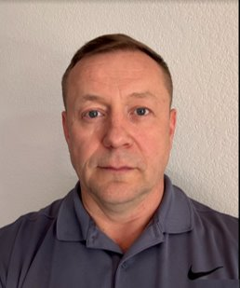

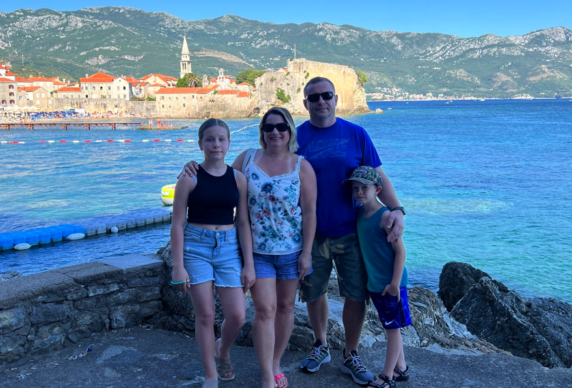
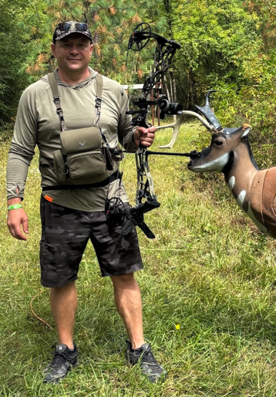
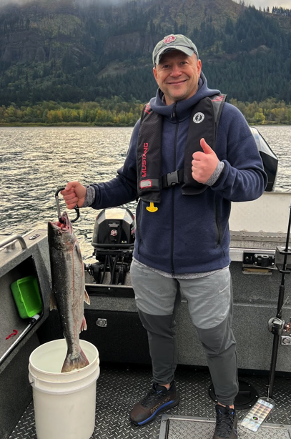
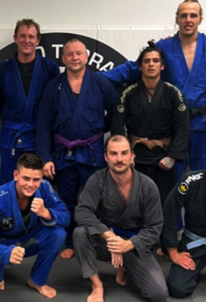
Alex Makarov
MY ALTER-EGO
Saved company $$$ in licensing and reducing cloud infrastructure expenses.
Developed automated database deployment pipelines across AWS, Azure, and Alibaba Cloud.
I started archery with my son during COVID, and it quickly turned into a passion that stuck with us
Home: Portland, OR
Family: Natalia (wife), Dasha (Daughters), Artyom ( Son)
Companies:
BPA, Kronos, Nike
Me in Three
Creative
Go-getter
Collaborator
Teamwork
Collaborative
Problem solving
Communication
Jiu Jitsu
Archery
Fishing
Hunting
Hiking
Alex M| LinkedIn

